Slide 1


ECEN 404: Final Demo Presentation Team 31 Members: Martin Rennaker Grant Franklin Yarentzy Magallanes
Sponsor: Rohith Kumar
TA: Rohith Kumar
Notes:
Howdy! We Chilly dogs our team members consist of Grant Franklin, Martin Rennaker, and me Yarentzy Magallanes. Our sponsor and TA is Rohith Kumar and this is our Final ECEN 404 Presentation

Slide 2
Product
The Chilly Dog provides ideal cabin conditions to allow your pet to safely stay unattended in a vehicle.
Does not rely on the battery or motor of your vehicle​
Receive real time ambient and cabin temperature readings​
Set a desired output temperature through the Chilly dog phone application​
Receive alerts for low battery and extreme temperature conditions
Notes:
***The chilly dog is a battery powered car A/C system. that can cool the inside of your vehicle without relying on the motor of your car or its battery.​
***Chilly Dog users will be able to receive real time temperature reading of the ambient and cabin temperature, adjust the desired output temperature using the chilly dog phone application, and even receive alerts when the device has low battery or conditions in the cabin become unfit for the pet. ​
​

Slide 3
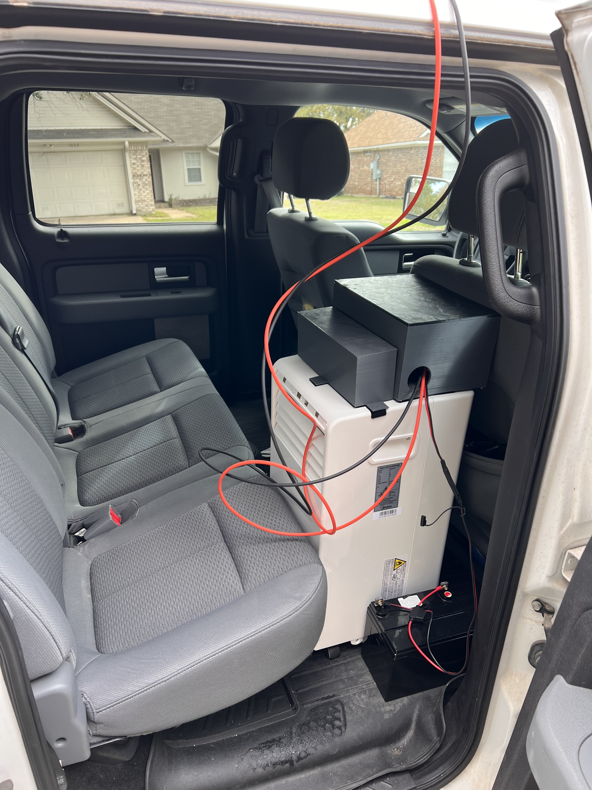
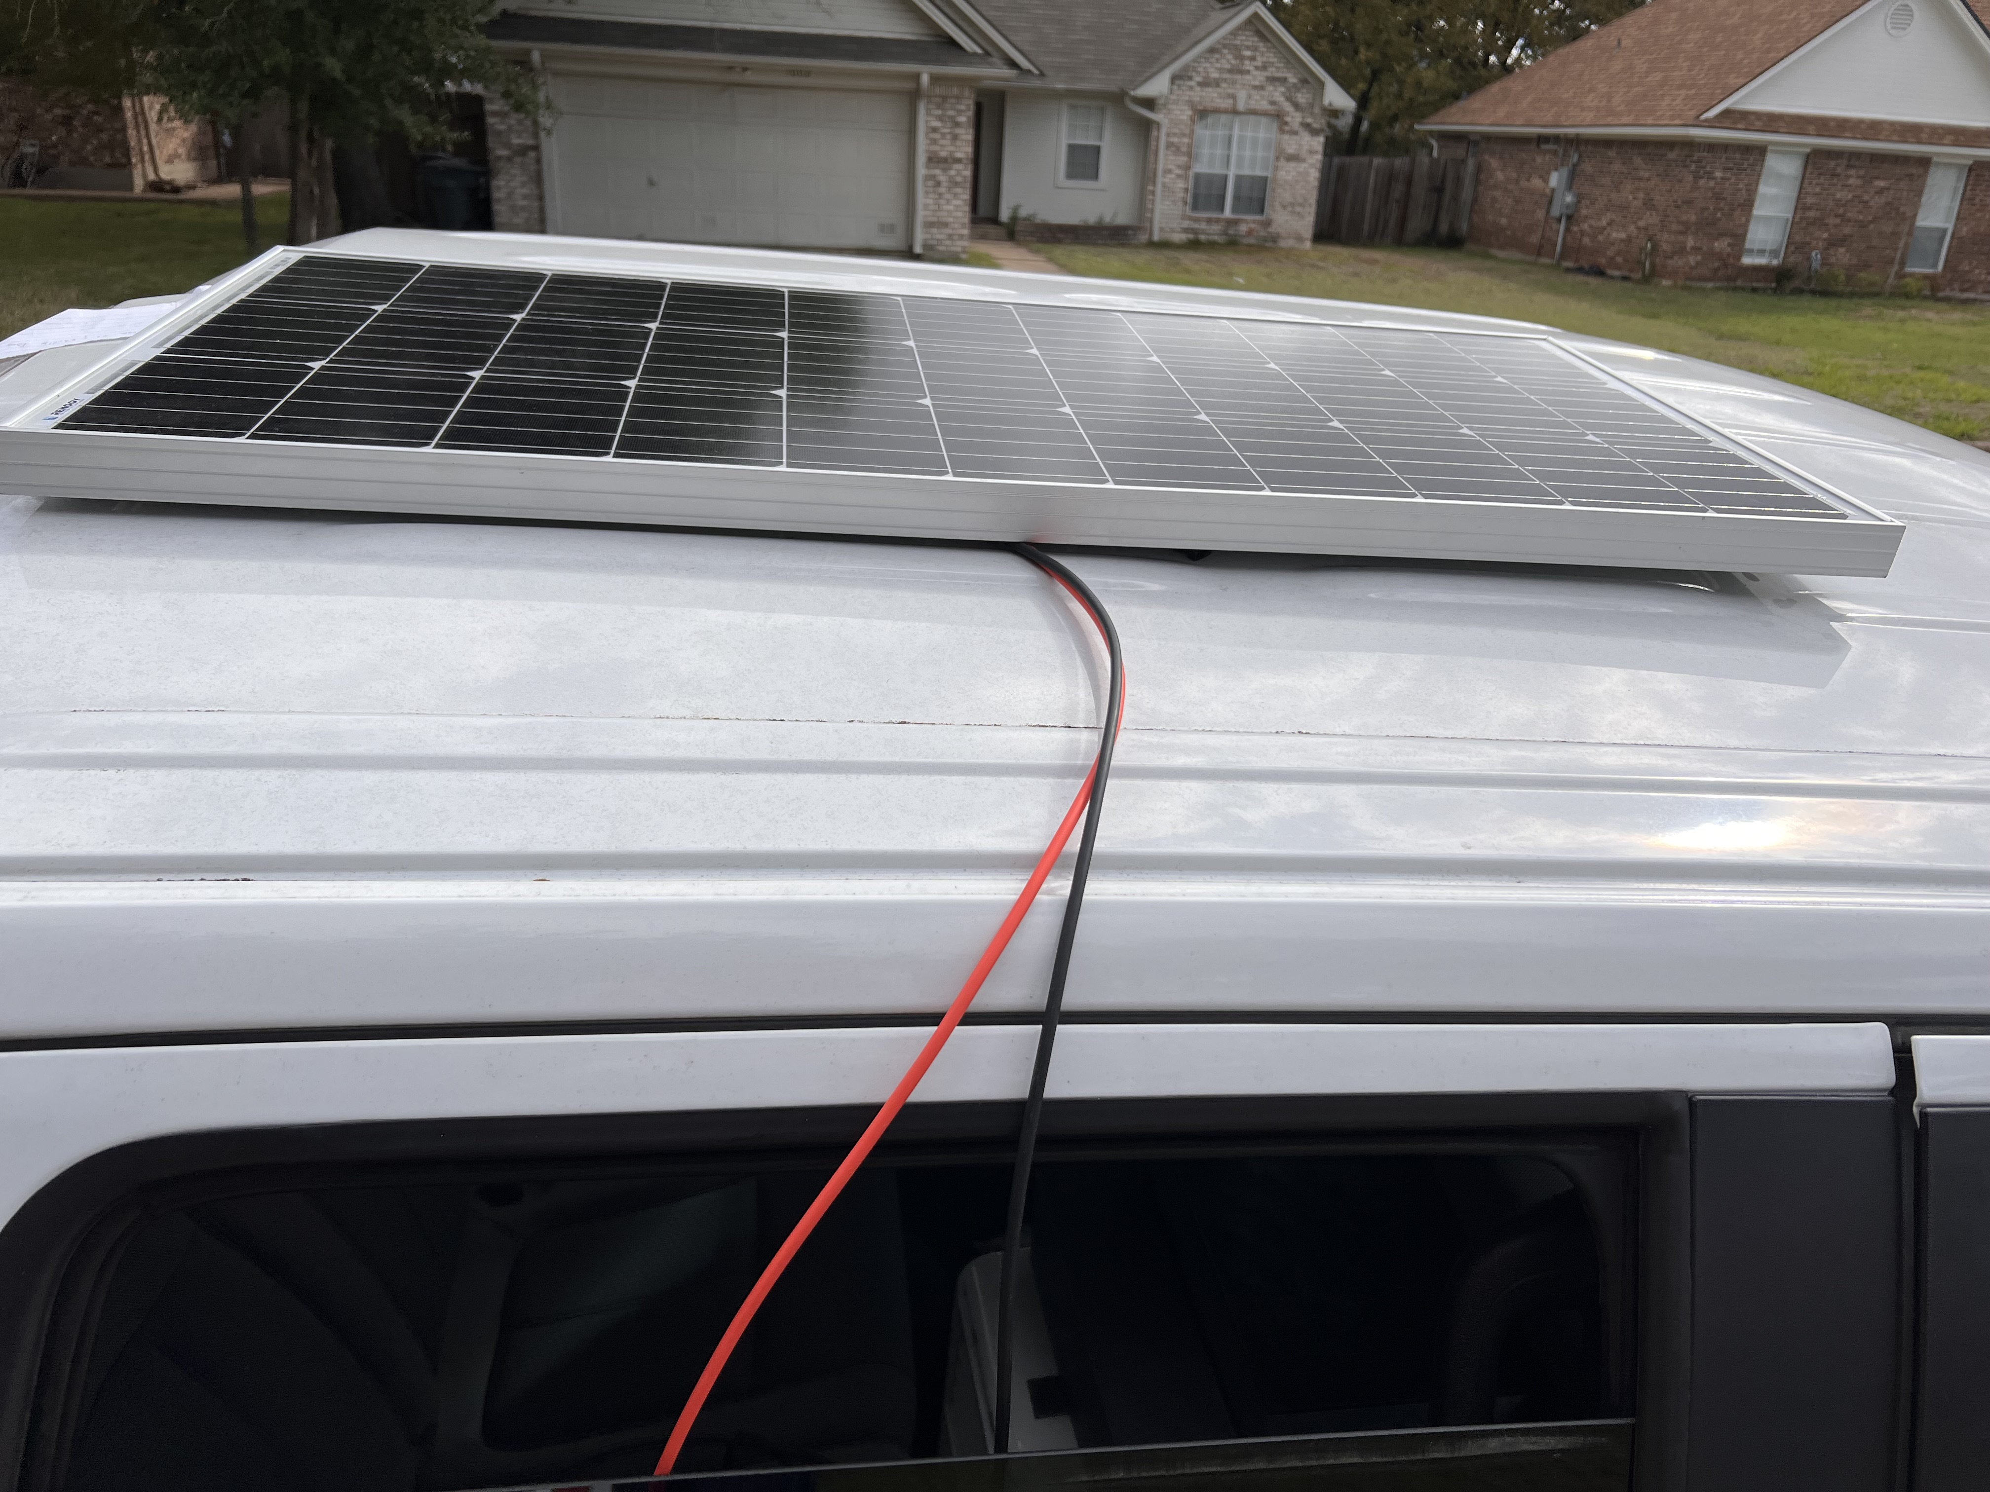
Set up
Notes:
Here is an image of how the chilly dog is installed in your vehicle. It is placed on the floor board occupying the area of only one seat with the exhaust exiting through the cracked window. The solar panel is mounted on the top of the vehicle with the connection running through the window as well.

Slide 4
Grant Franklin - Power
Design PCB and all circuits
Validation of consistent battery output of ~12V for the specified run time of 30 minutes
Validation of buck converters and battery life voltage divider on PCB using power supply 12V as well as battery
Validation of motors and 12V-5V converter using power supply as well as battery

Slide 5
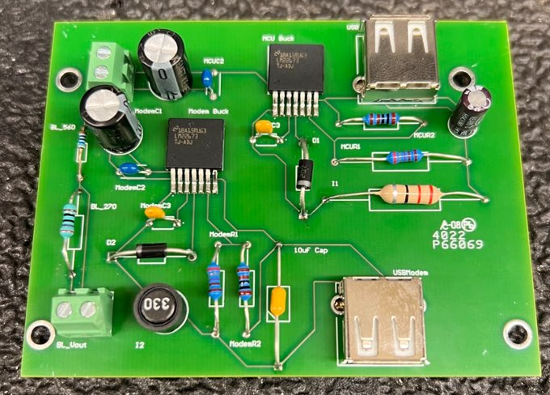
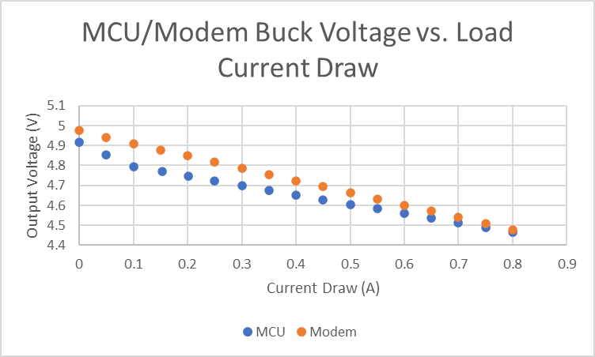
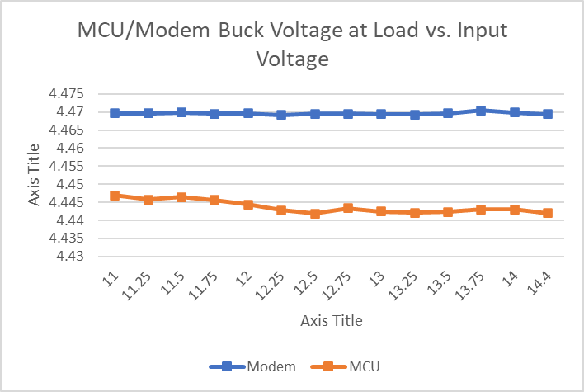
Grant Franklin - Power
PCB – Validate Buck Converters and Battery Life Voltage Divider
MCU only uses .28A and Modem only uses .2A, meaning that there will be very little variation in line/load tests
Notes:
Add lines

Slide 6
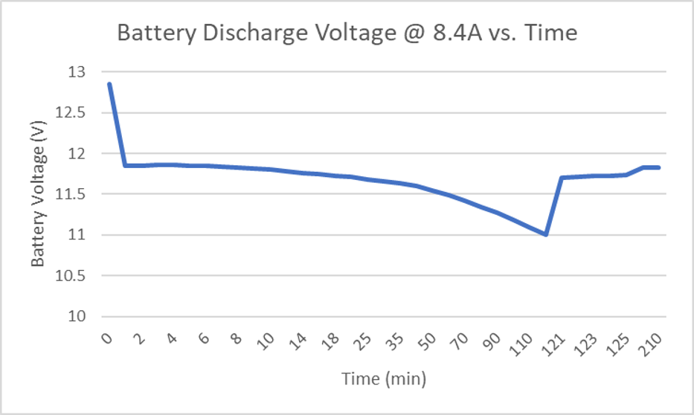
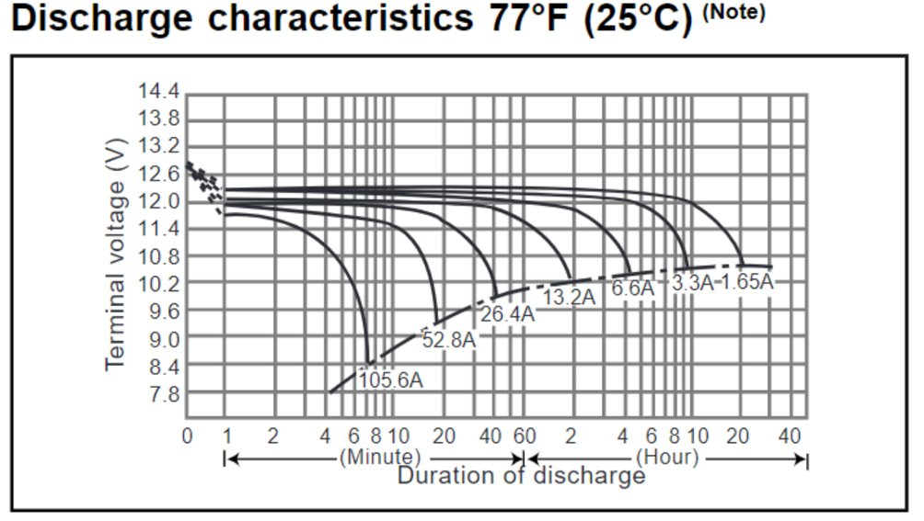
Validate Battery Characteristics
Discharging the Battery

Slide 7
Validate Battery Characteristics
Charging the Battery

Slide 8
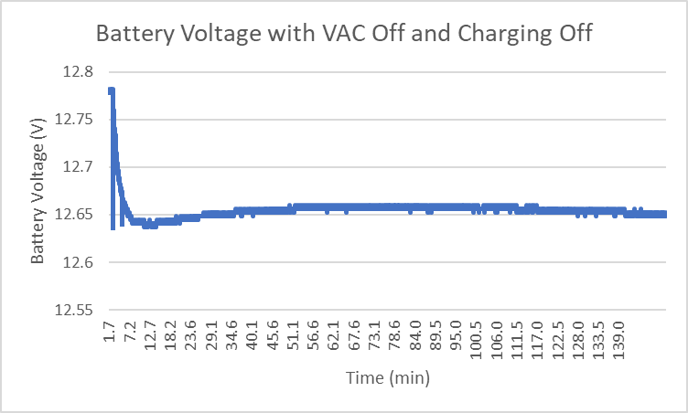
Full System Validation – Scenario 1
1: VAC off and Charging off
Notes:
What I care about. What the voltage started at. What it dropped to after load

Slide 9
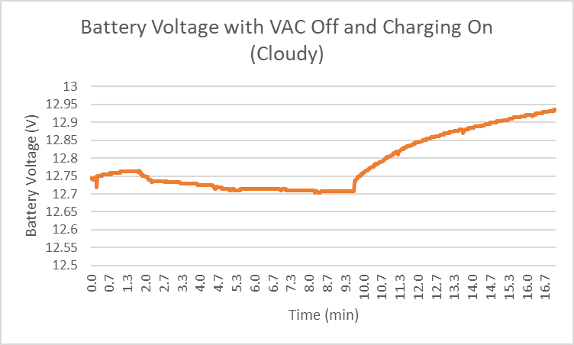
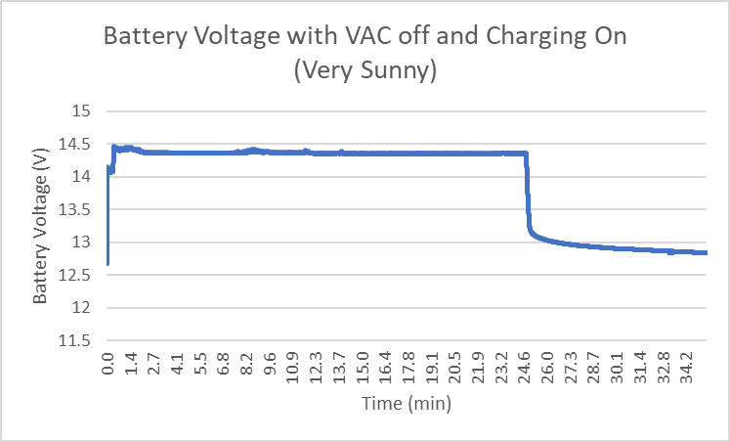
Full System Validation – Scenario 2
2: VAC off and Charging on
Notes:
What I care about. What the voltage started at. What it dropped to after load

Slide 10
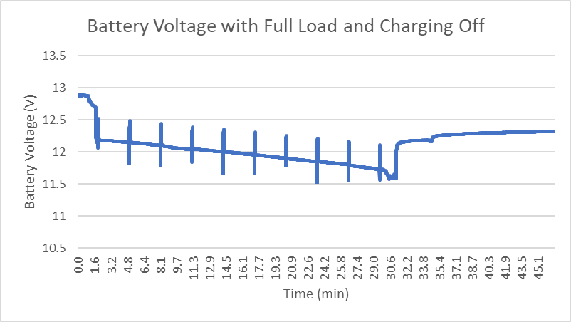
Full System Validation – Scenario 3 & 4
3: VAC on and Charging off
4: VAC on and Charging on

Slide 11
Grant Franklin - Power
System Problems and Solutions
System should last around 90 min, but our run time is ~35-45 min
Inverter sized to meet VAC specs online of 115V at 7.2A
2500-3000W inverter would need to be purchased, which is out of our budget
VAC datasheet seems to give a lower power draw than seen in testing
VAC seems to be drawing ~15A
Notes:
Is it for sure the inverter is failing?

Slide 12
Yarentzy - MCU
Arduino Uno
Digital I/O for temperature sensors
I2C to communicate with external ADC
UART Serial Communication with Bluetooth and modem
PWM for servo motor control
Non-Volatile memory for previous temperature storage
Notes:
The selected microcontroller for the Chilly Dog was originally the PIC24FJ128GA204. After working with the PIC for a semester we ran into issues when it came to integrating it to the modem and establishing communication via cellular data. The switch was made to the Arduino Uno as my teammate in charge of the modem found it to be better documented. Another issue encountered when using the PIC was while establishing communication with the temperature sensors.
Some of the key features of my subsystem include... we will dive deeper into these in the next slides

Slide 13
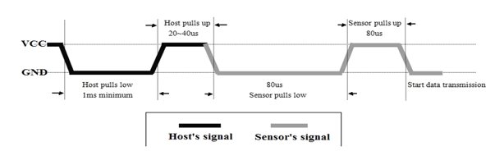
Temperature Sensors
DHT22
Low power consumption
Accurate readings +- 0.01 degree Celsius
Handshake
Notes:
The temperature sensor used for the data collection of the internal cabin, and outdoor conditions is the DHT22. These were chosen because of their high accuracy and low power consumption.
Here we can see an overview of the code to establish connection. After the handshake is complete the sensor will send pulses. The duration of the pulses being high or low will determine whether it is a 0 or a 1.

Slide 14
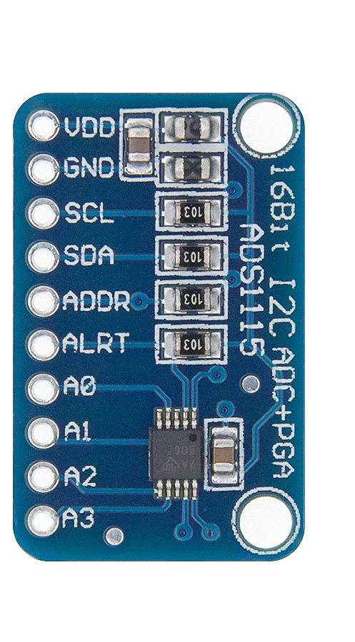
ADC
Arduino Uno 10-bit ADC
0 – 1023 with 0.004V of resolution
Insufficient for minimal voltage differences
ADS1115 16-bit ADC
0 – 65536 with 0.00007V of resolution
Communicates through I2C
Notes:
To read the battery percentage, grant has taken the voltage on the battery and stepped it down using a voltage divider to a range the Arduino can read. The 10 bit ADC equipped in the Arduino did not provide the desired resolution for our purposes so we used an external 16 bit ADC.

Slide 15
Battery Percentage
VAC ON
Percentage | 100 % | 75 % | 50 % | 25 % | 10 % | 5 %
Battery Voltage | 12.14 | 12.07 | 11.97 | 11.85 | 11.809 | 11.6
Stepped Down | 3.9334 | 3.9107 | 3.8784 | 3.8395 | 3.826 | 3.7586
Digital Value | 1963 | 1951 | 1935 | 1916 | 1909 | 1875
VAC OFF
Percentage | 100 % | 75 % | 50 % | 25 % | 10 % | 5 %
Battery Voltage | 12.75 | 12.55 | 12.35 | 12.15 | 12.07 | 12.01
Stepped Down | 4.1313 | 4.0666 | 4.0018 | 3.937 | 3.9107 | 3.8912
Digital Value | 2047 | 2029 | 1997 | 1964 | 1951 | 1942
Notes:
Here are the values that determine the battery percentage and their corresponding digital values. Here you can see how close the values are and the need for a 16 bit ADC. These cases are integrated in the code and represented on the app

Slide 16
EEPROM
memory whose values are kept when the board is turned off
Store previous temperature output
100,000 write/erase cycles
Notes:
EEPROM was used to store the previous temperature output set by the user for the case that the Arduino was turned off

Slide 17
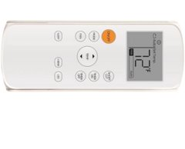
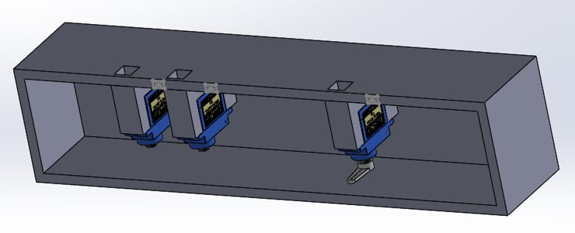
VAC Control
Attempt 1: Mimic IR signals from remote
Unsupported protocol
Attempt 2: Mechanical Control
Inconsistent button pressing
Success rate 12/20
Notes:
The VAC control was a process of trial and error. A huge limitation we had was the inability to dissect the VAC as the ECEN department would be using it for future projects. Here are some non invasive attempts I conducted. I first attempted to mimic the IR signals sent from the remote to the VAC unit. I was able to mimic a roku remote using the NEC IR protocol and gained full functionality of the tv. But when it came to the VAC this was unsuccessful due to a lack of support and documentation of the IR protocol used to communicate with the VAC.
My second thought was to mechanically press the buttons with servo motors. My first 3D mounting failed due to how finicky they were and would only successfully press the button 12 out of 20 times.

Slide 18
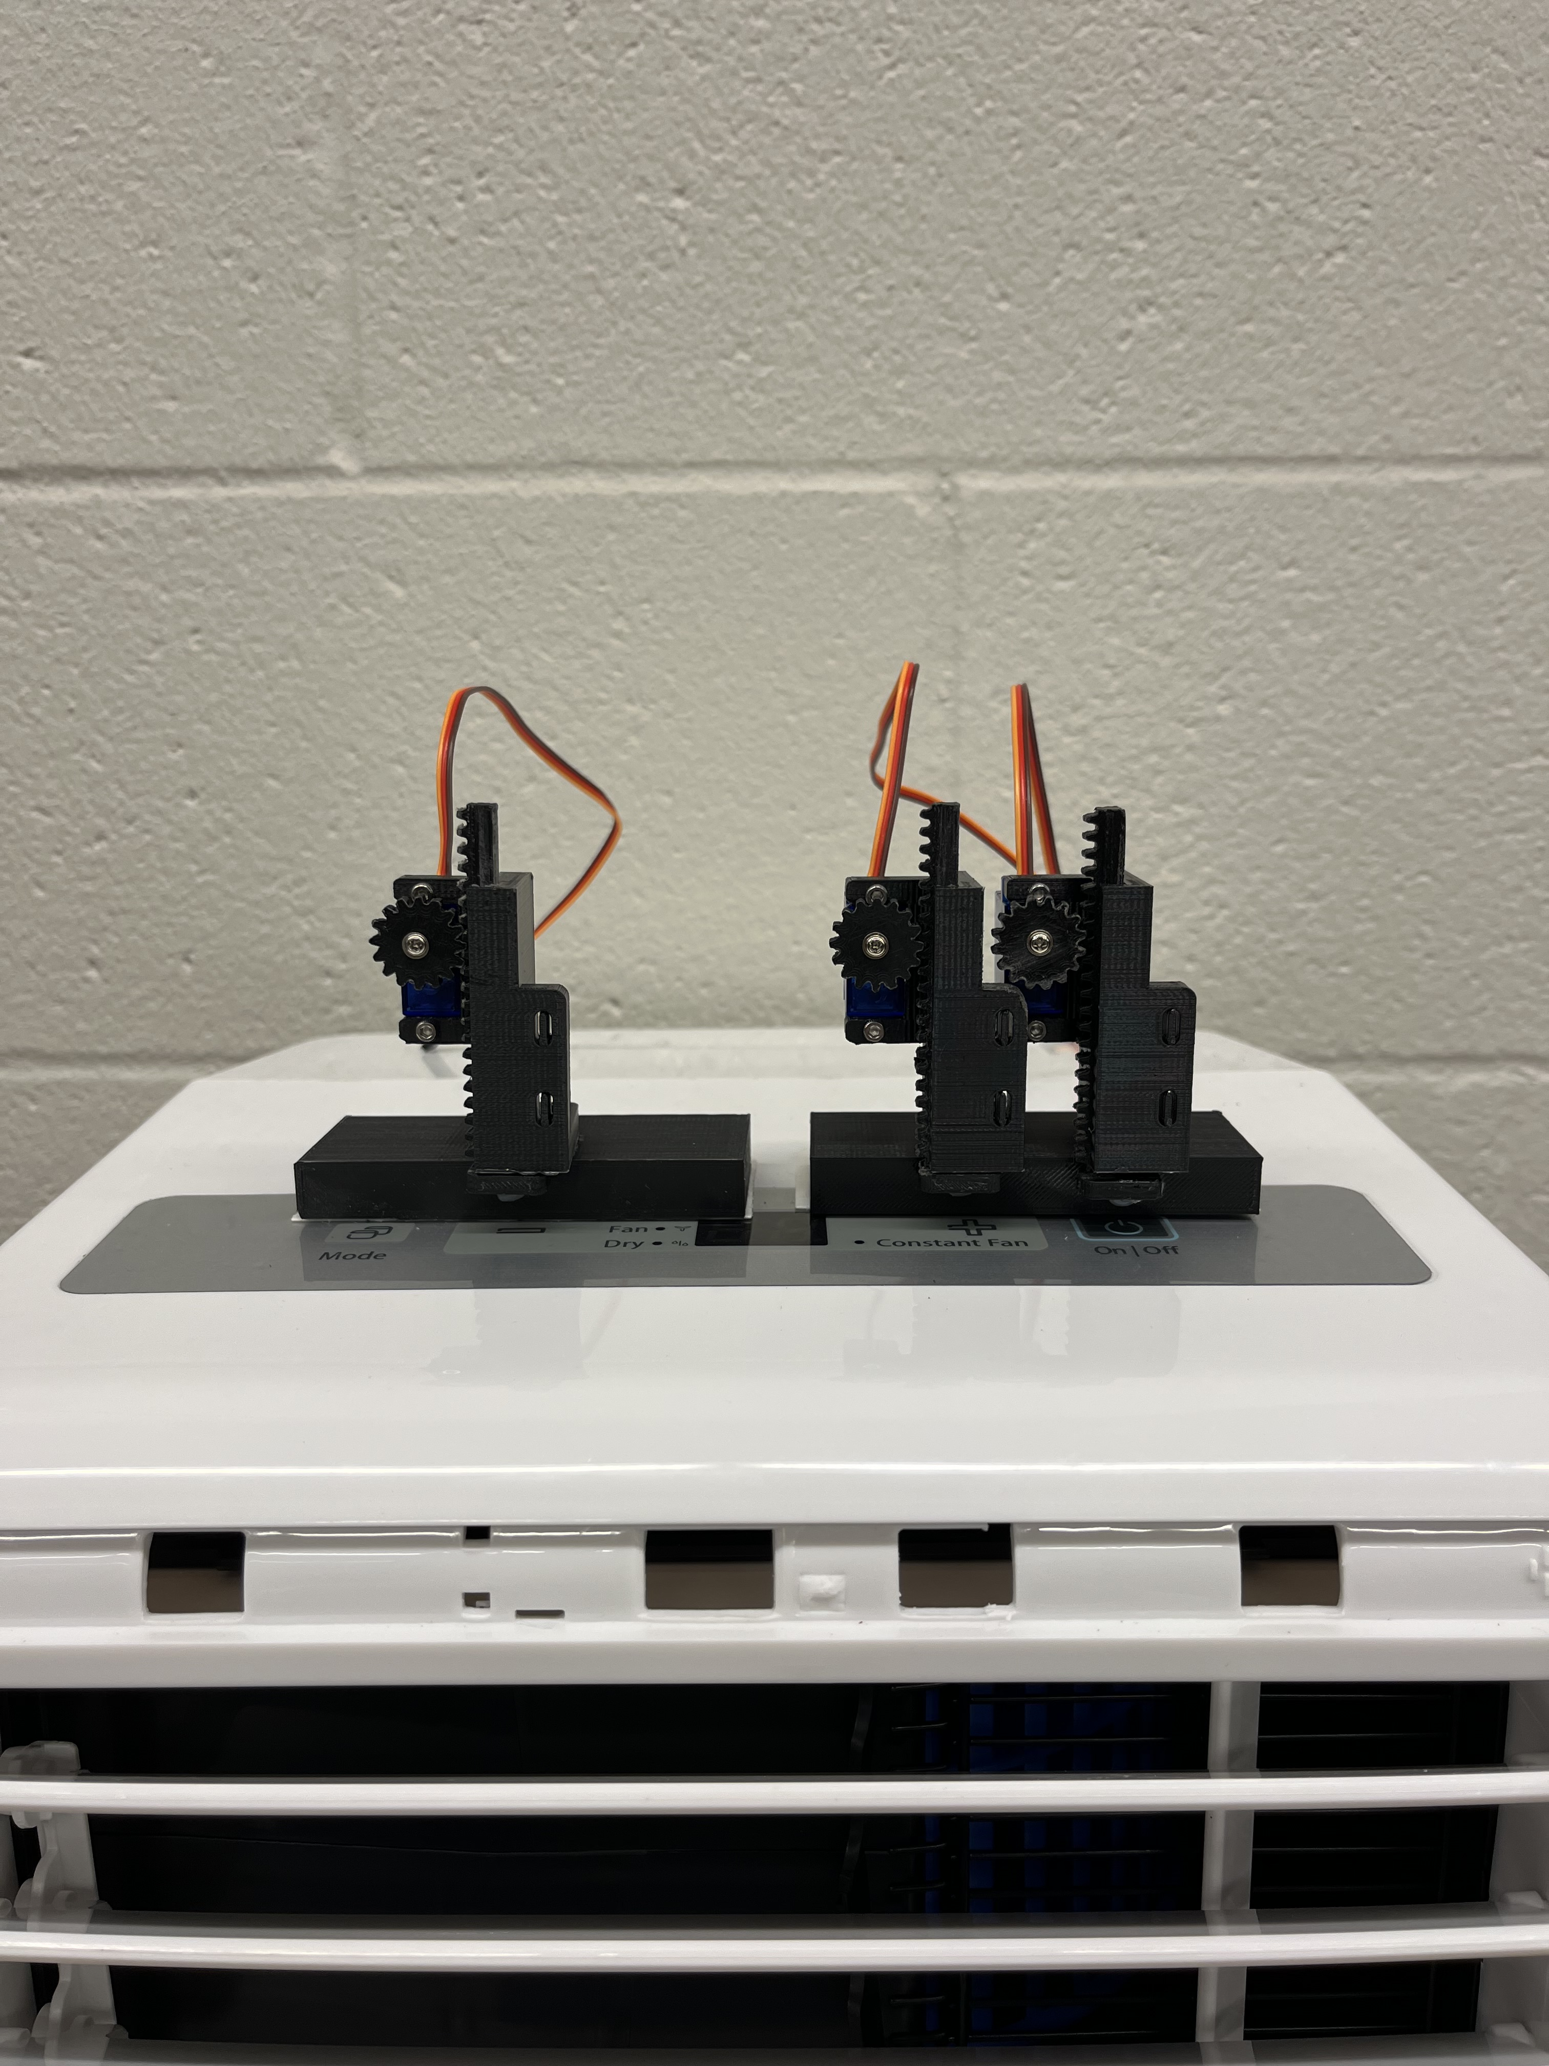
VAC Control
Attempt 3: Vertical Actuator
Success rate 20/20
Notes:
Finally I decided on the configuration of a vertical actuator which has a success rate of 20/20 and can removed after this semester.

Slide 19
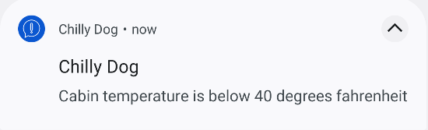
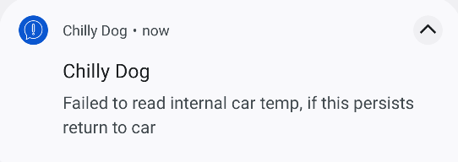
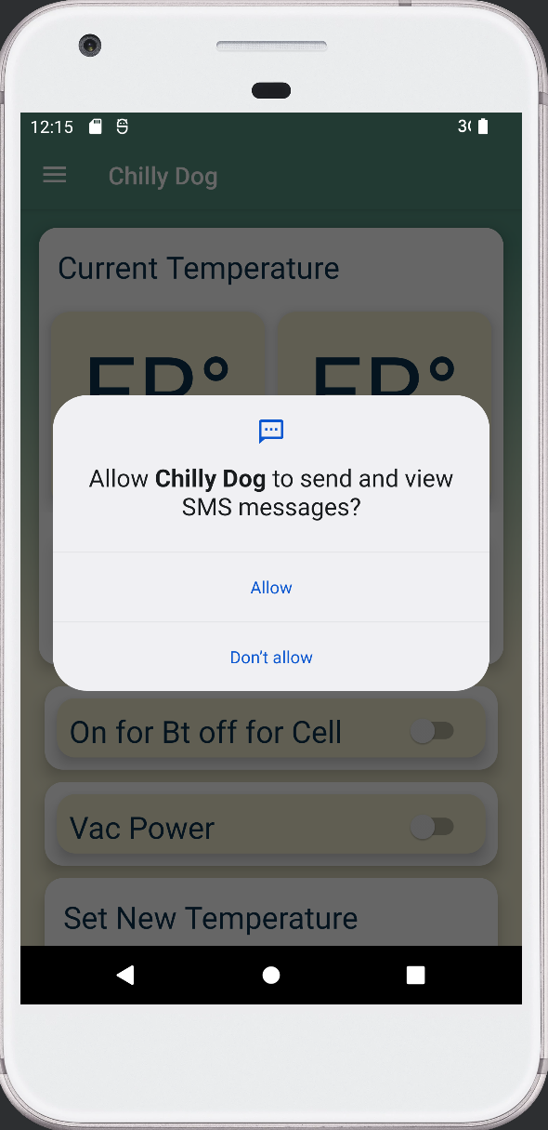
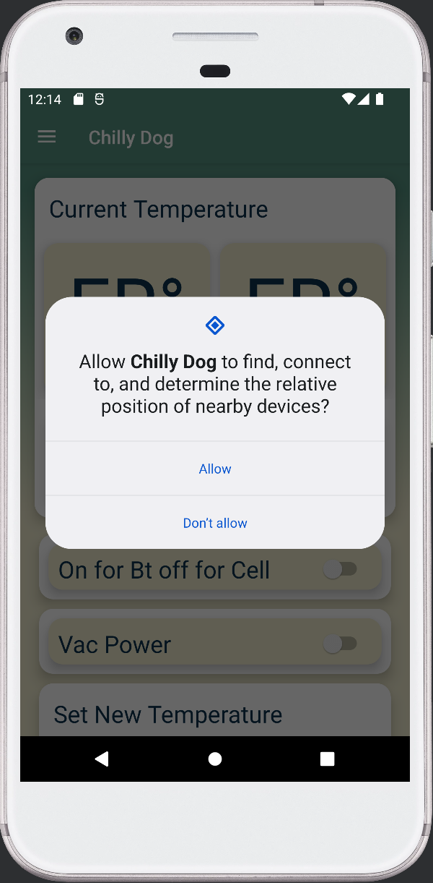
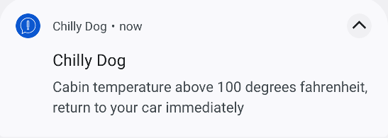
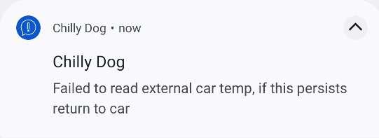
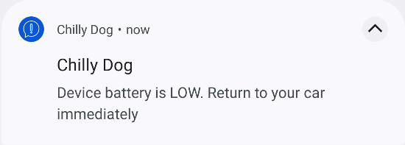
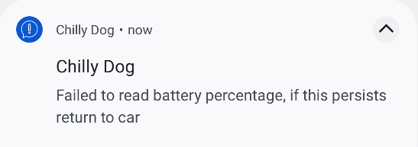
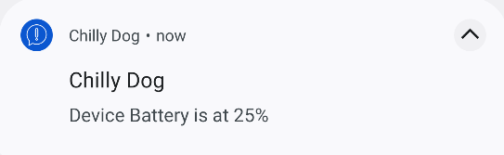
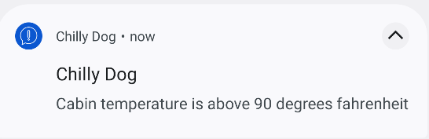
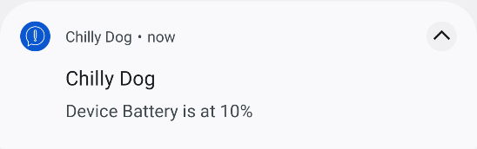
Application
All notifications the app can send
Popups displayed to user on startup

Slide 20
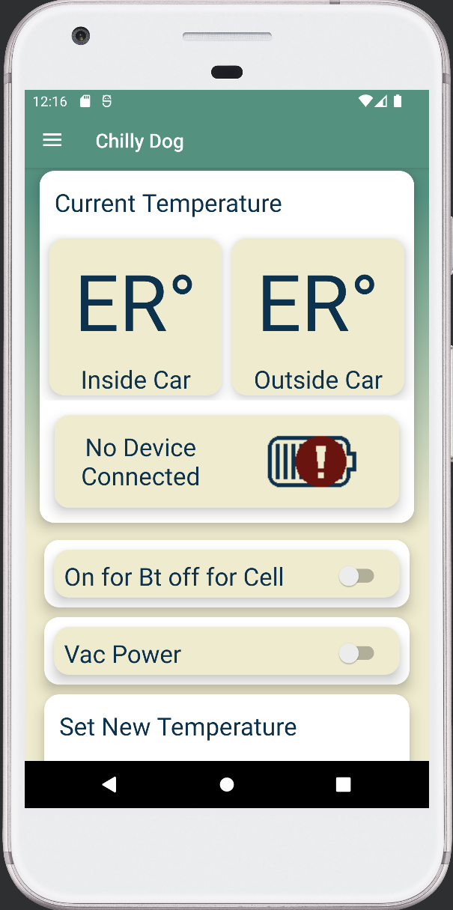
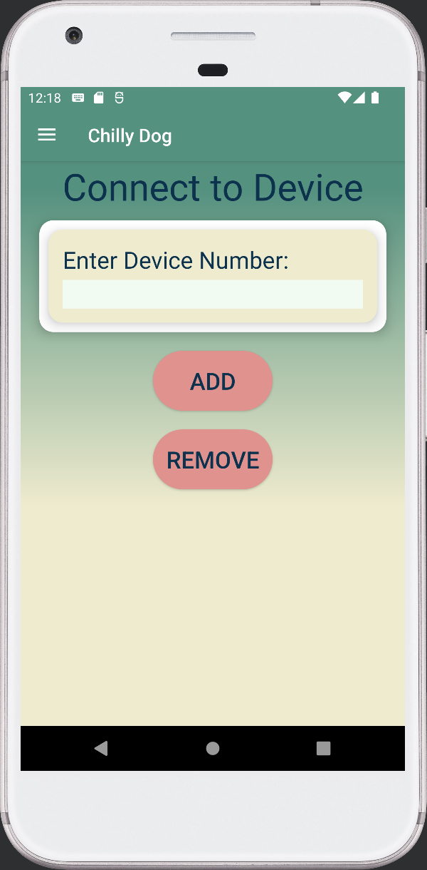
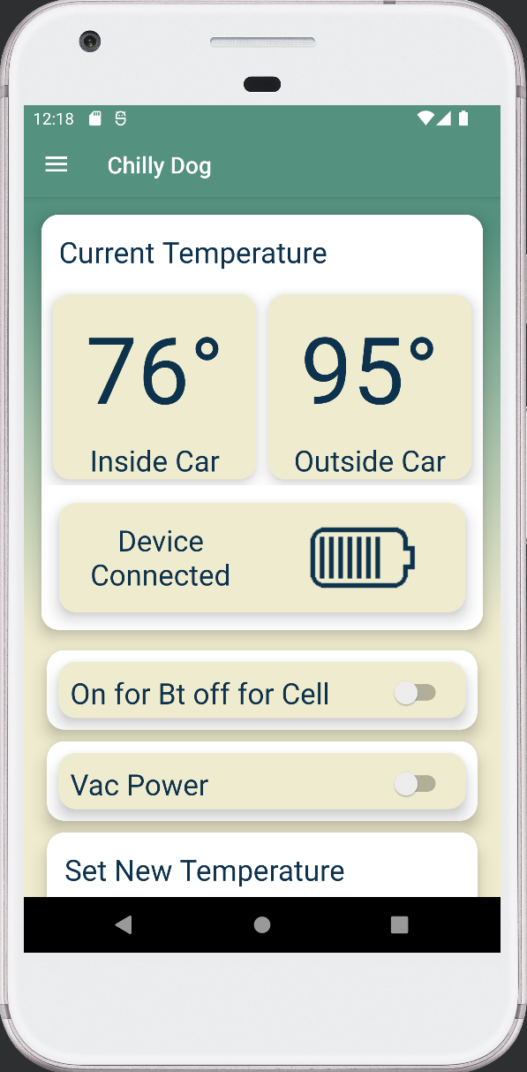
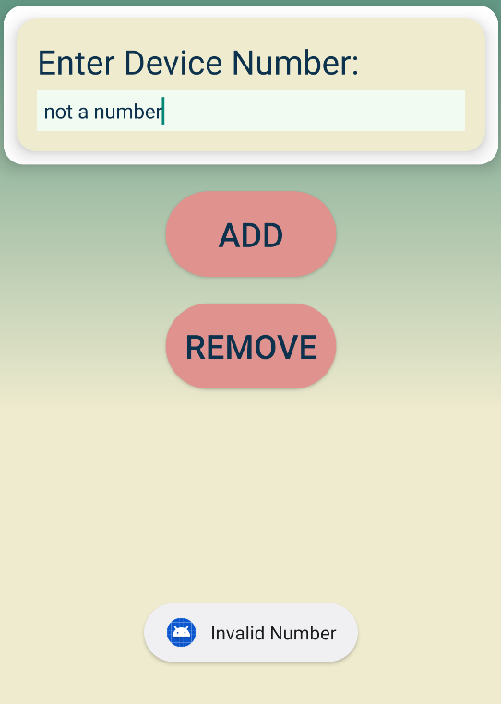
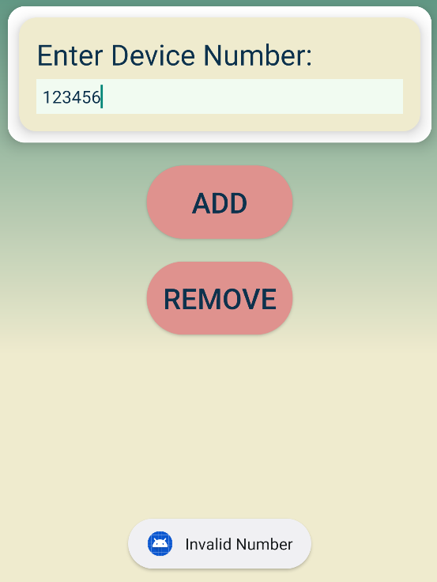
Application User flow
App opens with confirmations and then this unfilled screen
Go to connect a device page to type in the phone number of the chilly dog, box has error checking
App propagates with info from Arduino once a valid device has been entered

Slide 21
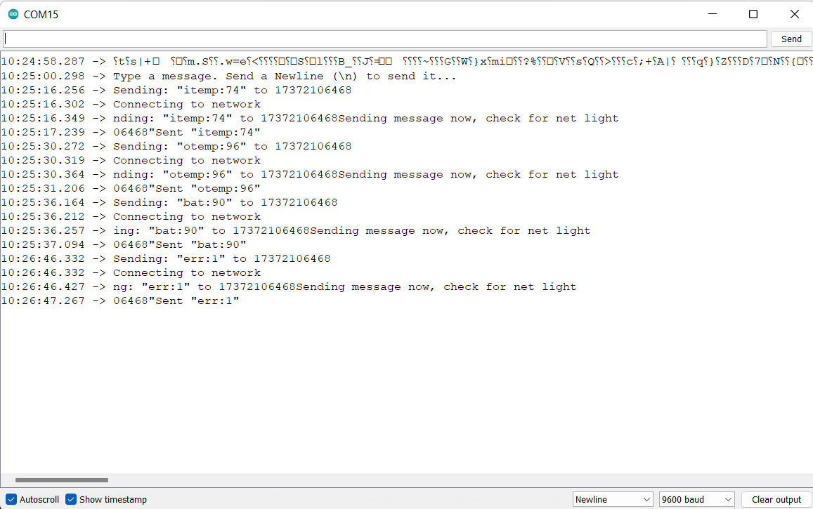
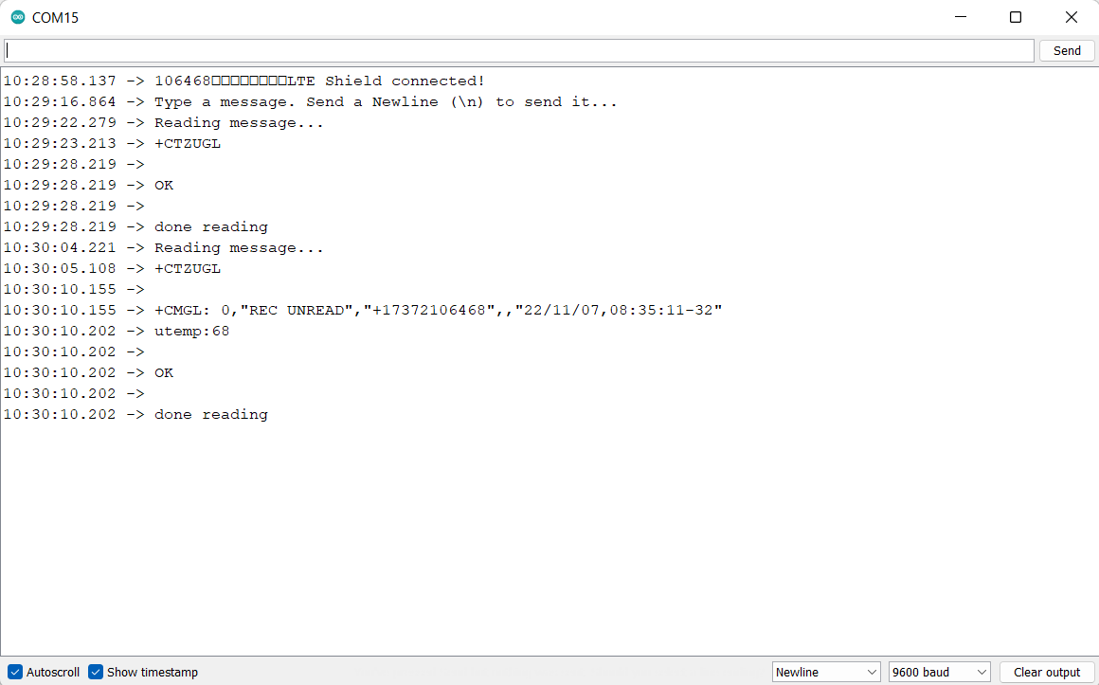
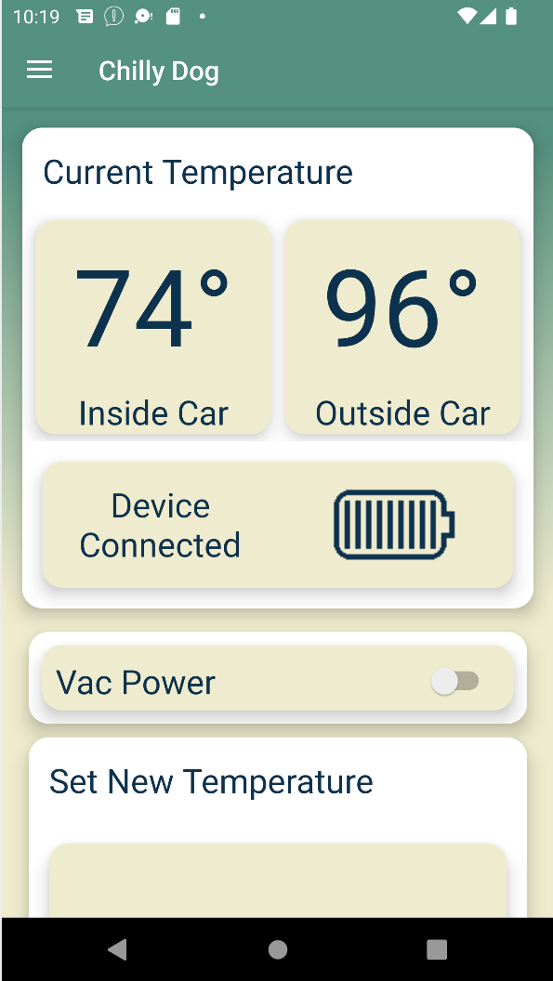
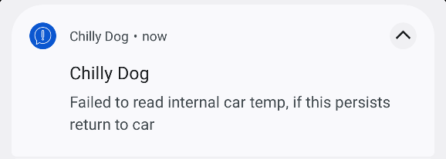
Modem
Sending
Receiving

Slide 22
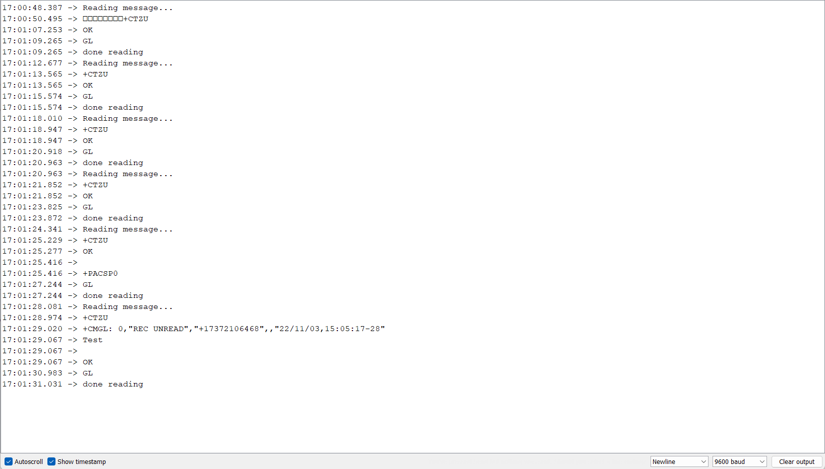
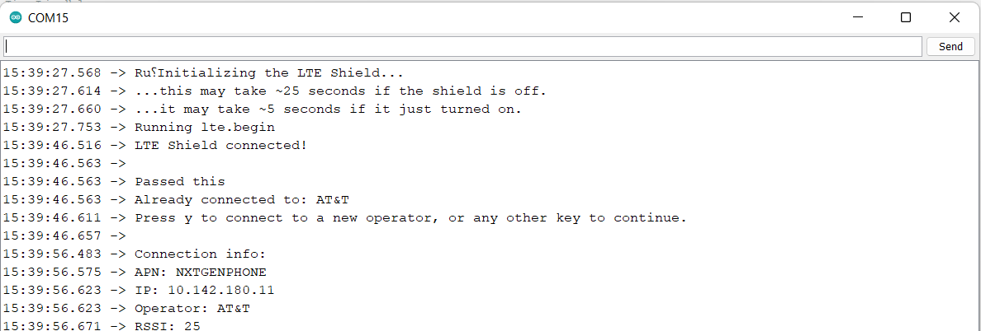
Modem Text Receiving
Message sent from phone when first read attempted
Message received 2 minutes later, this was one of the few examples of the modem receiving the texts
This shows the modem being recognized by AT&T and how they classify it
Notes:
EEPROM was used to store the previous temperature output set by the user for the case that the Arduino was turned off

Slide 23
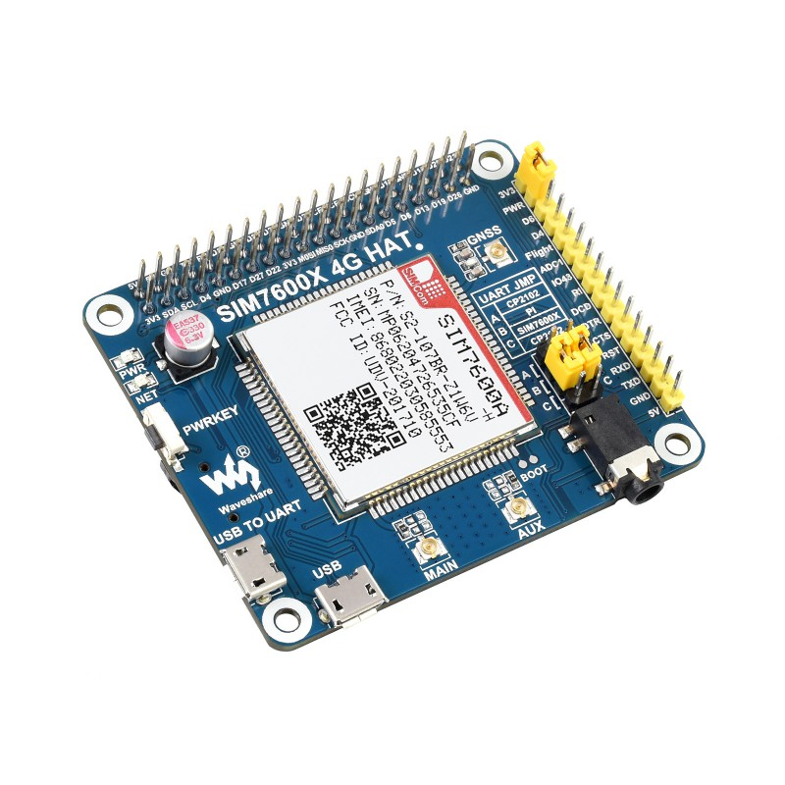
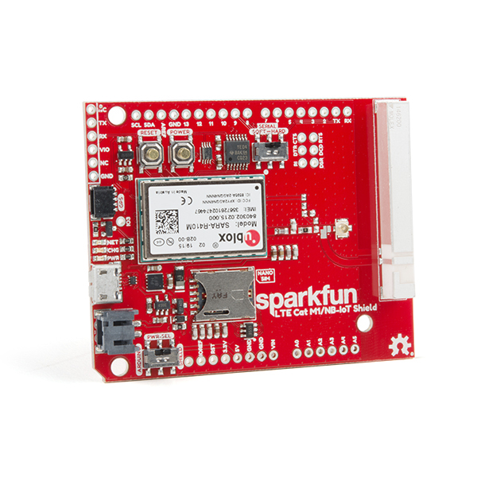
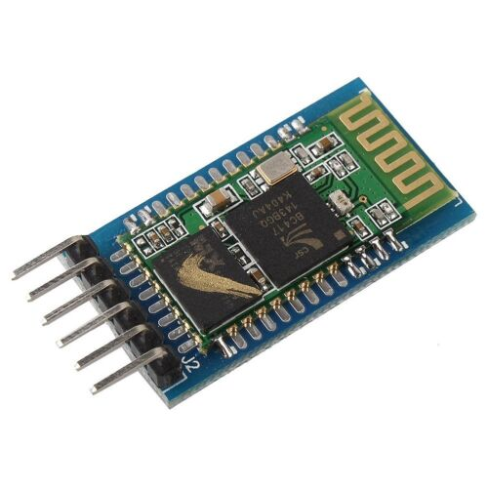
Modem issues
Waveshare Sim7600 4G Hat
Started with gsm
Moved to waveshare 7600
Had issues connecting it to the Pi
Then had issues with UART in 404
Broke one Waveshare, bought new one
UART still wasn’t working so switched to Sparkfun Sara R4
Still having issues with receiving texts so got a bluetooth module
Burned Sparkfun yesterday, fully implemented bluetooth
Sparkfun Sara R4
HC-05 Bluetooth Module

